Slide 1
Glove for Deaf Final Project
Team members:
- Osama youssef hamed 01004855118
- Karim mohamed elfarsy 01018857576
- Youssef barakat 01152658584

Slide 2
Agenda:
Problem Description.
Flowchart.
Coding.
Proteus Simulation.

Slide 3
Problem Description
As sign language is used by deaf people, the goal of this project is to create an embedded system that can translate the sign language into words using an LCD.
Flex sensors are normally used to give different voltages (different resistances) when the fingers move. These voltages are mapped and translated into words.

Slide 4
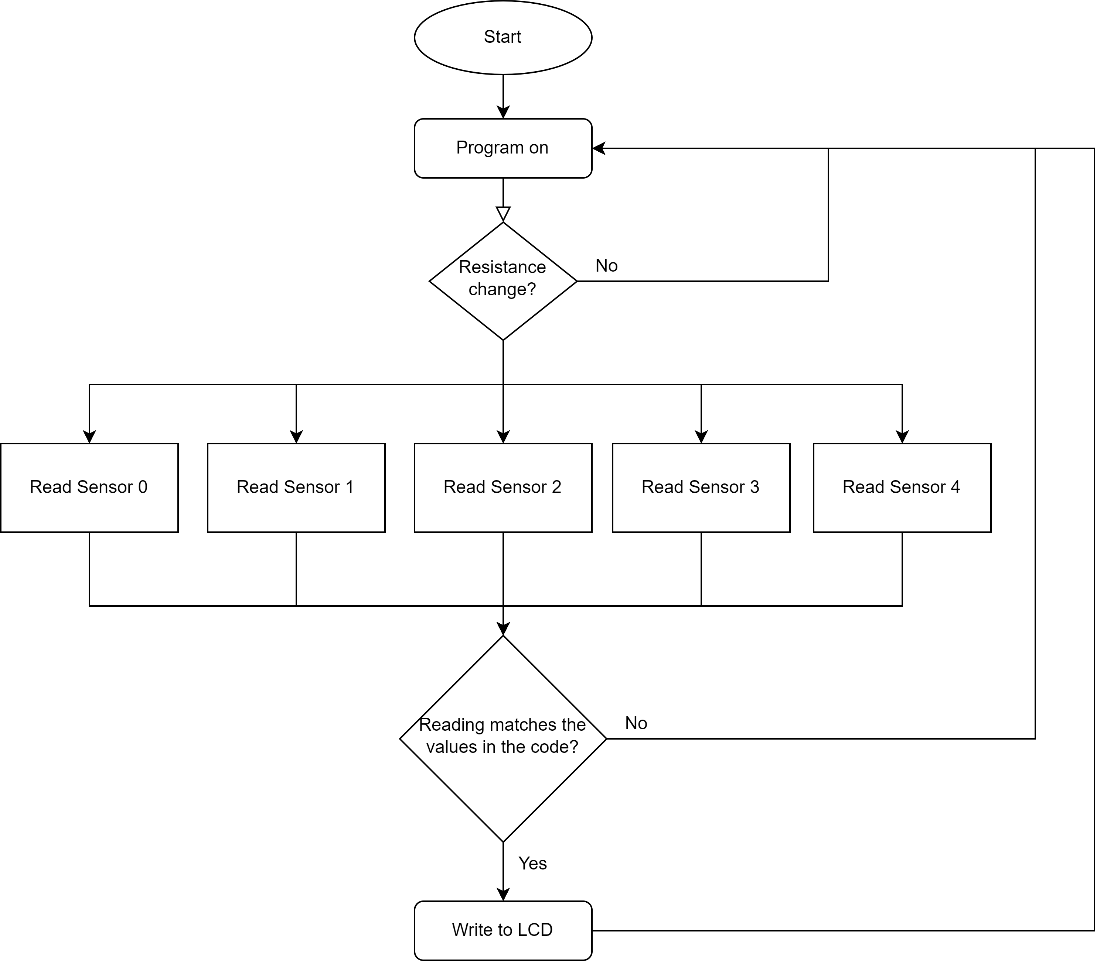
Flowchart

Slide 5
Coding
Layered Archeticture.
App layer: Bit Math, Main, and STD files.
ECUA layer: Flex sensor (potentiometers), and LCD.
MCAL layer: ADC and DIO.

Slide 6
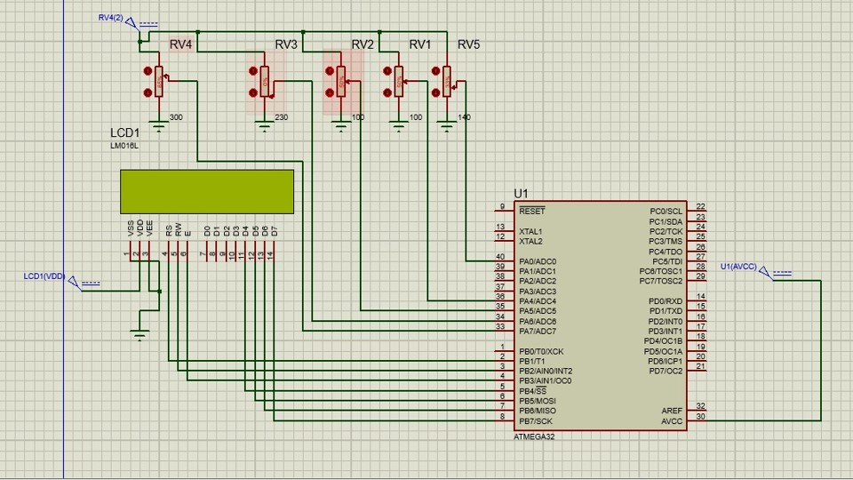
Proteus Simulation

Slide 7
Thank you

